Slide 1
Paris, France
I can recognize major cities in the Francophone world by their monuments, attractions, and culturally significant places.

Slide 2
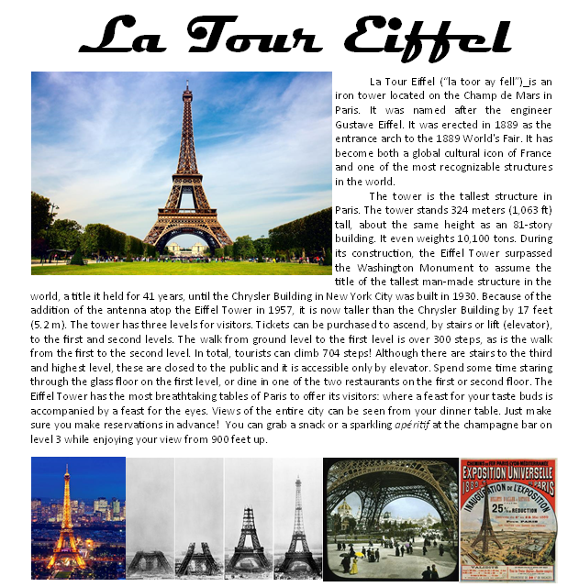
Comprehension
1. For how long was it the tallest structure in the world?
2. How many steps are tourists allowed to climb?
3. What is the Eiffel Tower made of?
4. What was it built for?
5. How tall is it?
6. What can you do at the Eiffel Tower?
7. If Mademoiselle’s Honda Civic weights around 2,739 lbs, how many of her cars would it take to match the weight of the Tower? Hint: one ton equals 2000 lbs.

Slide 3
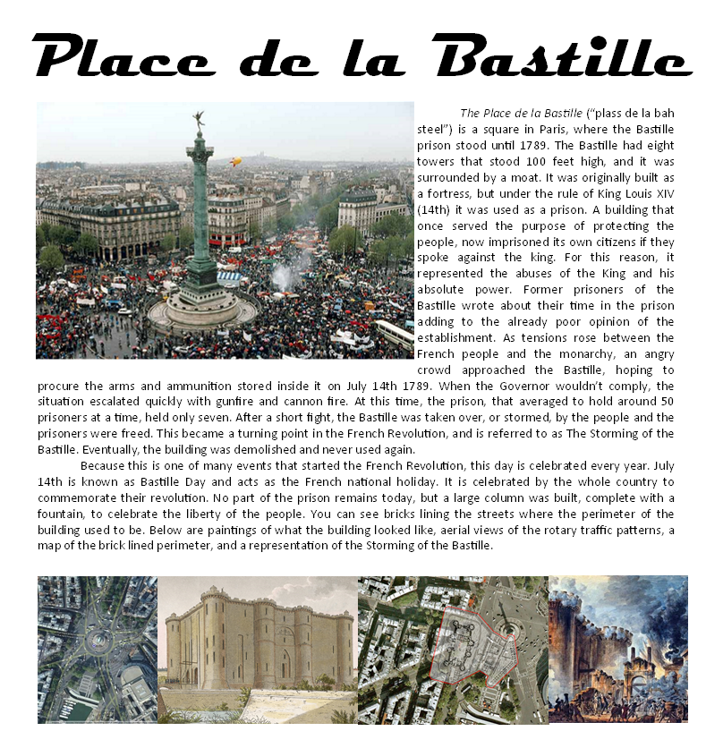
Comprehension
1. What was the Bastille?
2. Why did the people want to close the prison? (What did it represent?)
3. What day did the people ‘storm the bastille?’
4. Why do they celebrate this event still today?
5. On what similar holiday do we celebrate our independence?
6. What was the result of the storming of the bastille?
7. Today, what do you see at la Place de la Bastille?

Slide 4
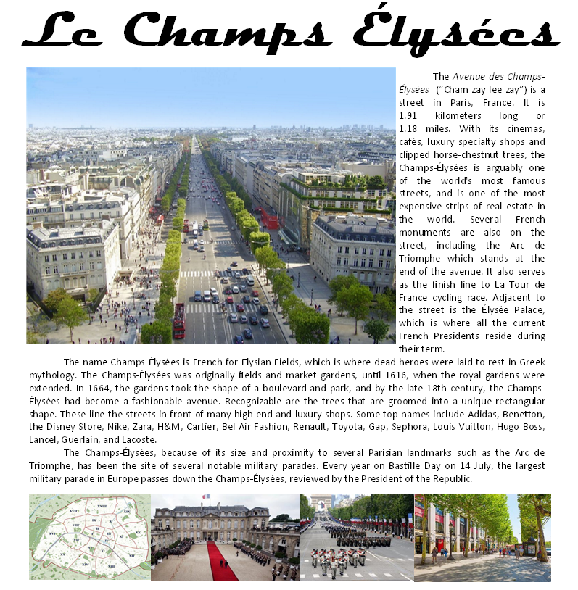
Comprehension
1. What is the Champs Élysées?
2. What can you find there?
3. What famous landmark stands tall at the end of the avenue?
4. What was it named after?
5. What do the trees that line the street look like?
6. Besides high end shopping and entertainment, what else is the street known for?
7. If 1.91 kilometers equals 1.18 miles, how many miles are there in one kilometer?

Slide 5
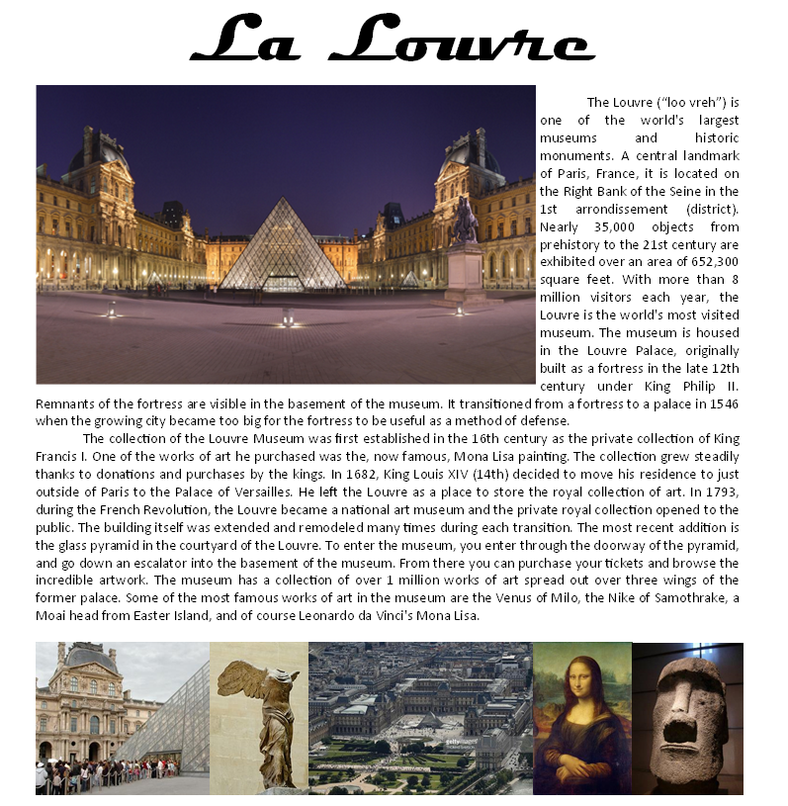
Comprehension
1. What is the Louvre today?
2. How many people visit the Louvre a year?
3. What was the Louvre originally?
4. Under whose rule was the Louvre built?
5. When did the Louvre become a public museum?
6. How many works of art are there?
7. What are some of the most famous works of art at the Louvre ?

